Slide 1
2
DERIVATIVES

Slide 2
2.7
Related Rates

Slide 3
Related Rates
If we are pumping air into a balloon, both the volume and the radius of the balloon are increasing and their rates of increase are related to each other.
However, it is much easier to measure directly the rate of increase of the volume than the rate of increase of the radius.

Slide 4
Related Rates
In a related rates problem the idea is to compute the rate of change of one quantity in terms of the rate of change of another quantity (which may be more easily measured).
The procedure is to find an equation that relates the two quantities and then use the Chain Rule to differentiate both sides with respect to time.

Slide 5
Example 1
Air is being pumped into a spherical balloon so that its volume increases at a rate of 100 cm³/s. How fast is the radius of the balloon increasing when the diameter is 50 cm?
SOLUTION:
We start by identifying two things:
the given information:
the rate of increase of the volume of air is 100 cm³/s
and the unknown:
the rate of increase of the radius when the diameter is 50 cm

Slide 6
Example 1 – Solution
cont’d
In order to express these quantities mathematically, we introduce some suggestive notation:
Let V be the volume of the balloon and let r be its radius.
The key thing to remember is that rates of change are derivatives.
In this problem, the volume and the radius are both functions of the time t.

Slide 7
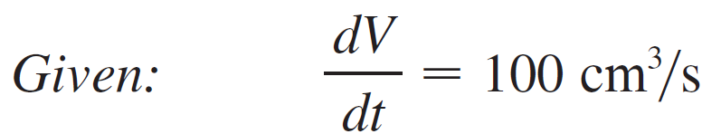
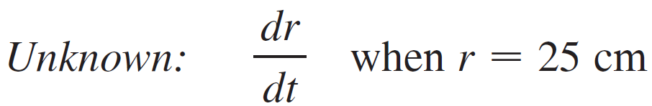
Example 1 – Solution
cont’d
The rate of increase of the volume with respect to time is the derivative dV/dt, and the rate of increase of the radius is dr/dt.
We can therefore restate the given and the unknown as follows:

Slide 8

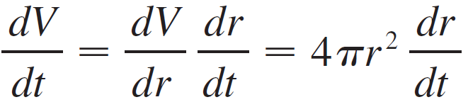
Example 1 – Solution
cont’d
In order to connect dV/dt and dr/dt, we first relate V and r by the formula for the volume of a sphere:
In order to use the given information, we differentiate each side of this equation with respect to t.
To differentiate the right side, we need to use the Chain Rule:

Slide 9
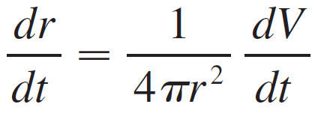

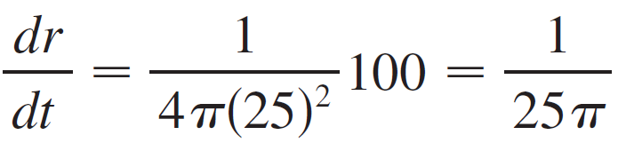
Example 1 – Solution
cont’d
Now we solve for the unknown quantity:
If we put r = 25 and in this equation, we obtain
The radius of the balloon is increasing at the rate of 1/(25π) ≈ 0.0127 cm/s.

Slide 10
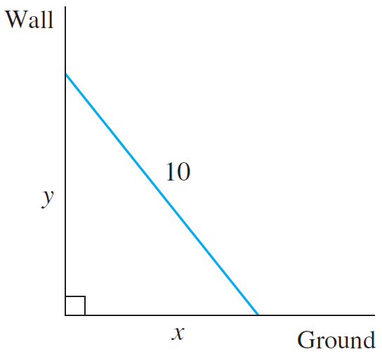
Example 2
A ladder 10 ft long rests against a vertical wall. If the bottom of the ladder slides away from the wall at a rate of 1 ft / s, how fast is the top of the ladder sliding down the wall when the bottom of the ladder is 6 ft from the wall?
SOLUTION:
We first draw a diagram and label it as in Figure 1.
Figure 1

Slide 11
Example 2 – Solution
cont’d
Let x feet be the distance from the bottom of the ladder to the wall and y feet the distance from the top of the ladder to the ground. Note that x and y are both functions of t (time, measured in seconds).
We are given that dx/dt = 1 ft/s and we are asked to find dy/dt when x = 6 ft.(See Figure 2.)
Figure 2

Slide 12

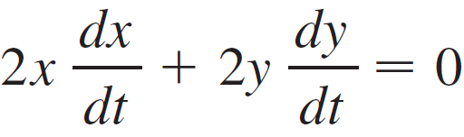
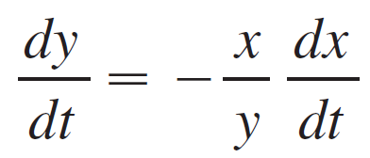
Example 2 – Solution
cont’d
In this problem, the relationship between x and y is given by the Pythagorean Theorem:
Differentiating each side with respect to t using the Chain Rule, we have
and solving this equation for the desired rate, we obtain

Slide 13
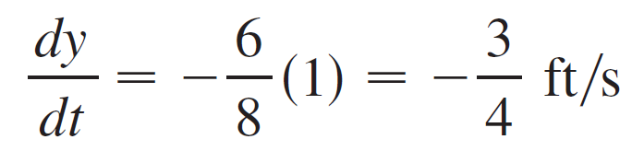

Example 2 – Solution
cont’d
When x = 6, the Pythagorean Theorem gives y = 8 and so, substituting these values and dx/dt = 1 we have
The fact that dy/dt is negative means that the distance from the top of the ladder to the ground is decreasing at a rate of
In other words, the top of the ladder is sliding down the wall at a rate of

Slide 14
Example 3
A water tank has the shape of an inverted circular cone with base radius 2 m and height 4 m.
If water is being pumped into the tank at a rate of 2 m³/min, find the rate at which the water level is rising when the water is 3 m deep.

Slide 15
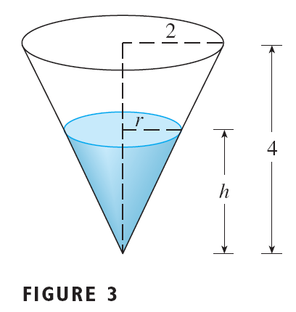
Example 3 SOLUTION
We first sketch the cone and label it as in Figure 3. Let
V is the volume of the water.
r is the radius of the surface.
h is the height of the water at time t, where t is measured in minutes.

Slide 16
Example 3 SOLUTION
We are given that dV / dt = 2 m³/min and we are asked to find dh / dt when h is 3 m.
The quantities V and h are related by the equation
However, it is very useful to express V as a function of h alone.

Slide 17
Example 3 SOLUTION
To eliminate r, we use the similar triangles in the figure to write:
The expression for V becomes:

Slide 18
Example 3 SOLUTION
Now, we can differentiate each side with respect to t:
So,

Slide 19
Example 3 SOLUTION
Substituting h = 3 m and dV / dt = 2 m³/min, we have:
The water level is rising at a rate of 8/(9π) ≈ 0.28 m/min.

Slide 20
Related Rates
Strategy
Examples 1–2 suggest the following steps in solving related rates problems:
1. Read the problem carefully.
2. Draw a diagram if possible.
3. Introduce notation. Assign symbols to all quantities that are functions of time.

Slide 21
Related Rates
4. Express the given information and the required rate in terms of derivatives.
5. Write an equation that relates the various quantities of the problem. If necessary, use the geometry of the situation to eliminate one of the variables by substitution.
6. Use the Chain Rule to differentiate both sides of the equation with respect to t.
7. Substitute the given information into the resulting equation and solve for the unknown rate.
The following examples are further illustrations of the strategy.

Slide 22
Example 4
Car A is traveling west at 50 mi/h and car B is traveling north at 60 mi/h.
Both are headed for the intersection of the two roads.
At what rate are the cars approaching each other when car A is 0.3 mi and car B is 0.4 mi from the intersection?

Slide 23
Example 4 SOLUTION
We draw Figure 4, where C is the intersection of the roads.
At a given time t, let x be the distance from car A to C.
Let y be the distance from car B to C.
Let z be the distance between the cars, where x, y, and z are measured in miles.

Slide 24
Example 4 SOLUTION
We are given that dx / dt = – 50 mi/h and dy / dt = – 60 mi/h.
The derivatives are negative because x and y are decreasing.
We are asked to find dz / dt.

Slide 25
Example 4 SOLUTION
The equation that relates x, y, and z is given by the Pythagorean Theorem: z² = x² + y²
Differentiating each side with respect to t, we have:

Slide 26
Example 4 SOLUTION
When x = 0.3 mi and y = 0.4 mi, the Pythagorean Theorem gives z = 0.5 mi.
So,
The cars are approaching each other at a rate of 78 mi/h.

Slide 27
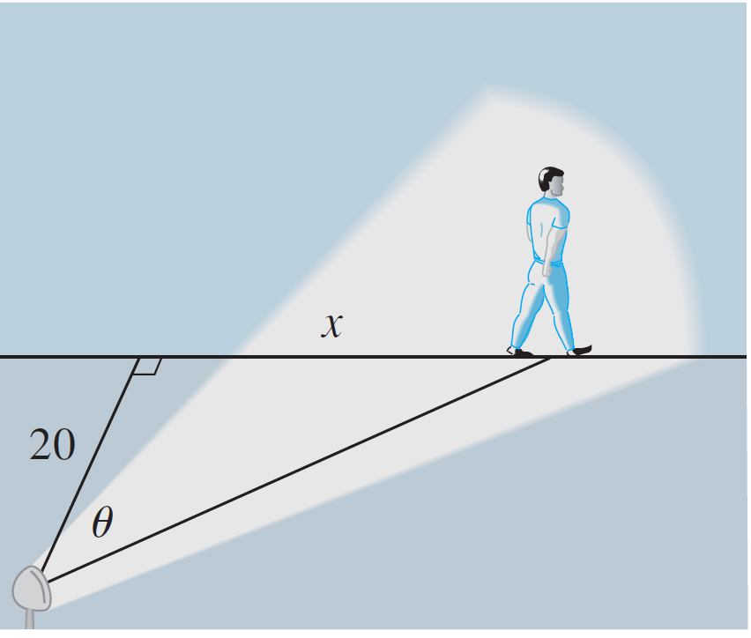
Example 5
A man walks along a straight path at a speed of 4 ft/s. A searchlight is located on the ground 20 ft from the path and is kept focused on the man. At what rate is the searchlight rotating when the man is 15 ft from the point on the path closest to the searchlight?
SOLUTION:
We draw Figure 5 and let x be the distance from the man to the point on the path closest to the searchlight.
Figure 5

Slide 28
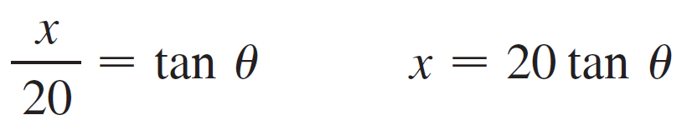
Example 5 – Solution
cont’d
We let θ be the angle between the beam of the searchlight and the perpendicular to the path.
We are given that dx/dt = 4 ft/s and are asked to find dθ/dt when x = 15.
The equation that relates x and θ can be written from Figure 5:

Slide 29
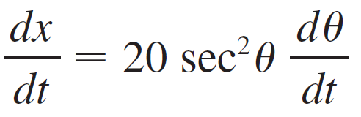
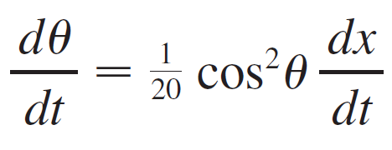
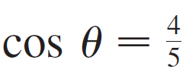
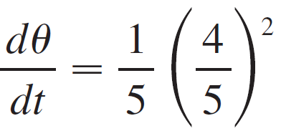

Example 5 – Solution
cont’d
Differentiating each side with respect to t, we get
so
When x = 15 ft, the length of the beam is 25 ft, so and
The searchlight is rotating at a rate of 0.128 rad/s.

